Slide 1
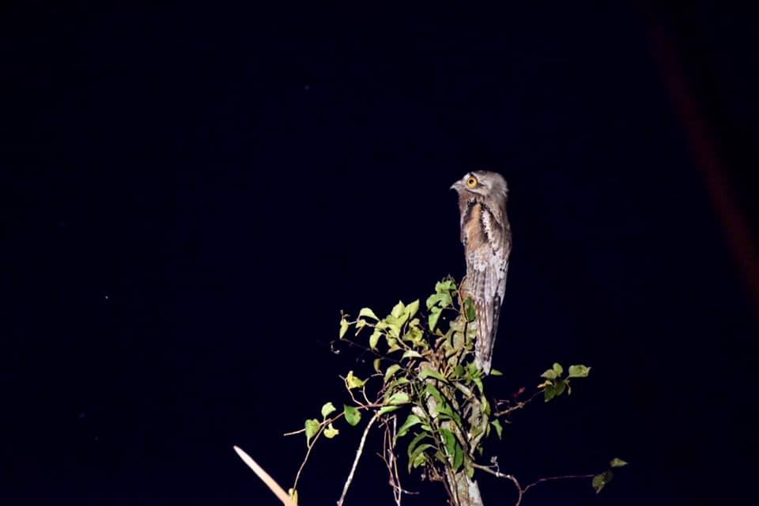
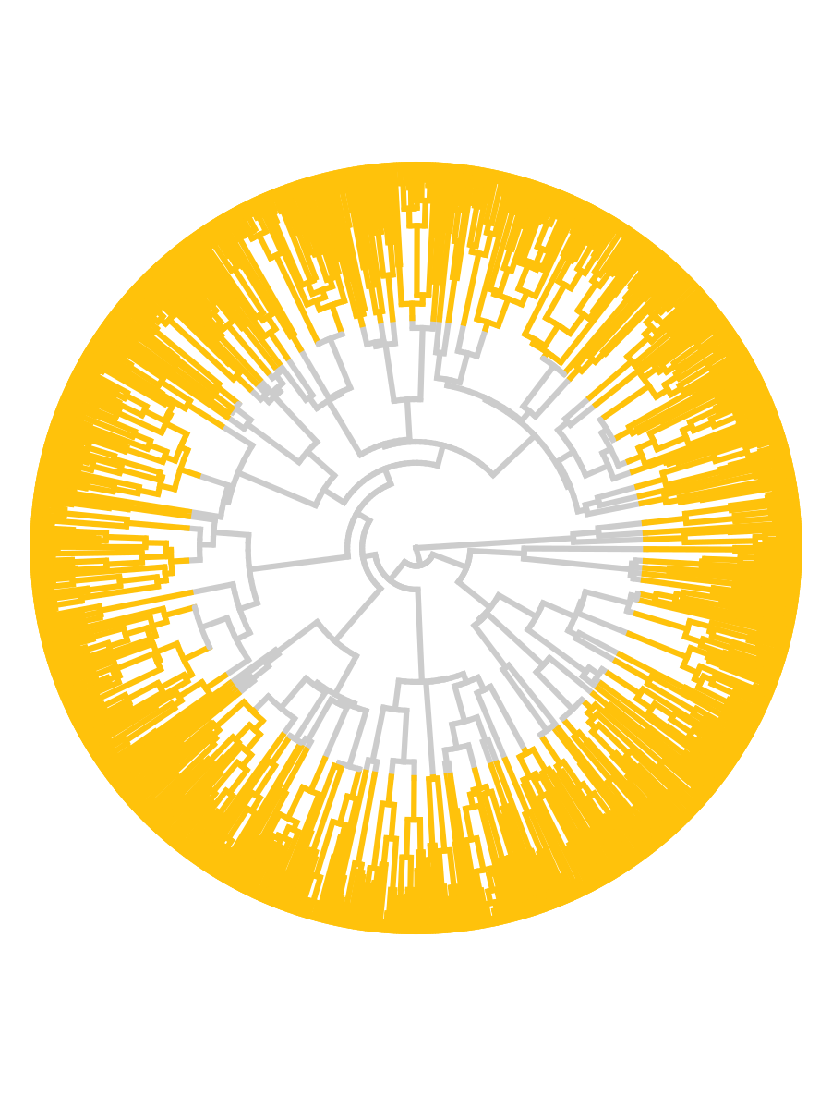
Modeling adaptation on trees Chamela workshop SSB 2023
Josef C Uyeda
Virginia Tech
juyeda@vt.edu

Slide 2
Workshop outline
Theory behind OU Models in PCMs
Lecture: Why use OU models? Lab: Gain an intuition for OU models Understand parameters & interactions Implementations in R packages
OUwie - Shifting optima & niche breadth slouch - Chasing peaks and phylogenetic inertia Finding shifts Multivariate OU models Everything, everywhere, all at once Using PCMFit - Constraints, constraints, constraints

Slide 3
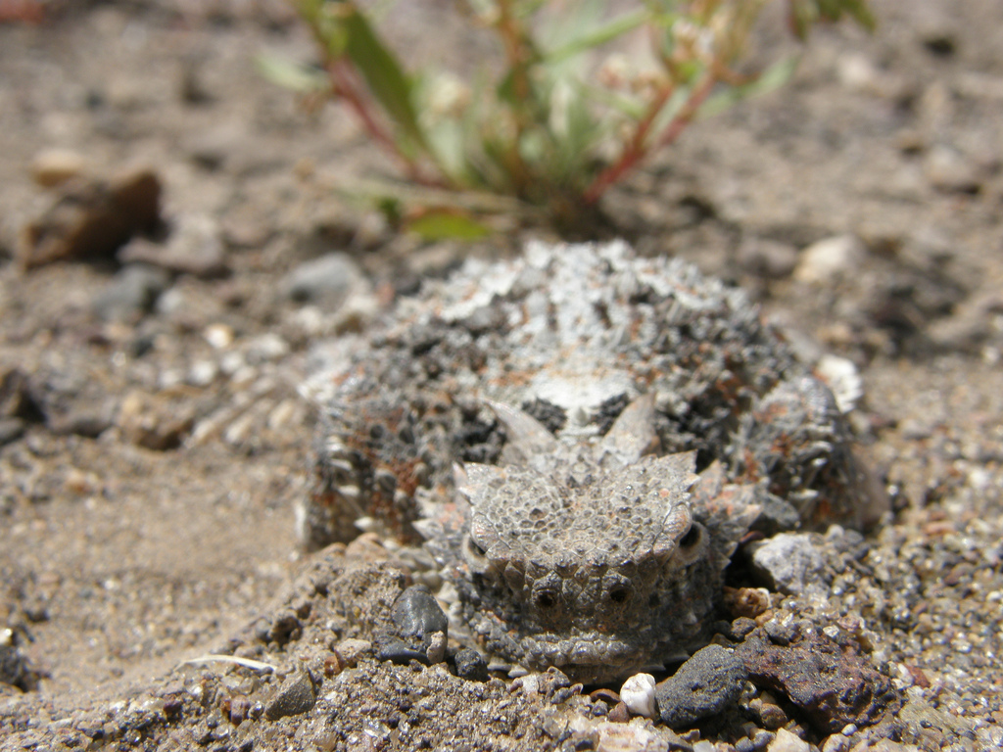

Slide 4
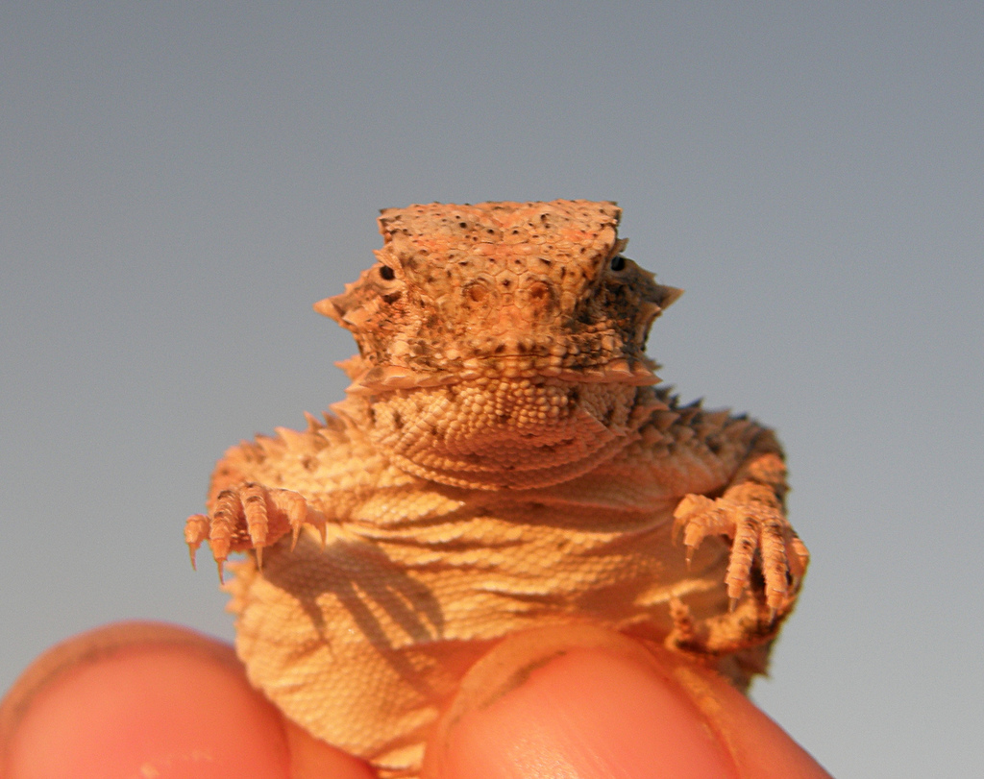

Slide 5
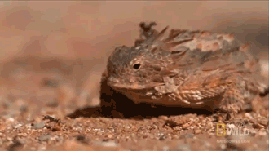

Slide 6
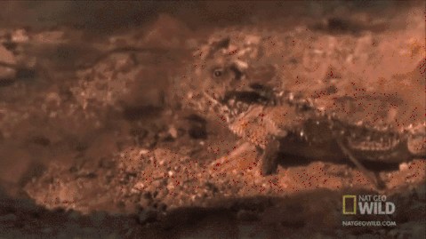

Slide 7

Horned lizards are cool

Slide 8
What caused these adaptations?

Slide 9
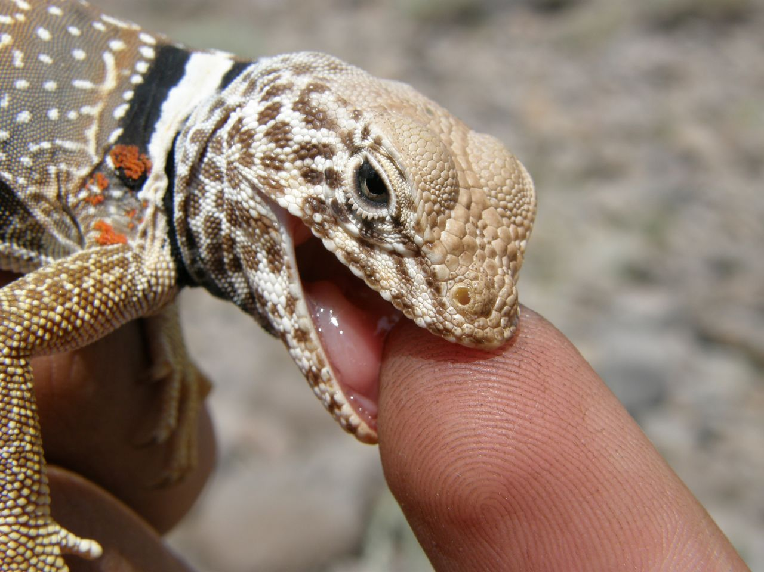
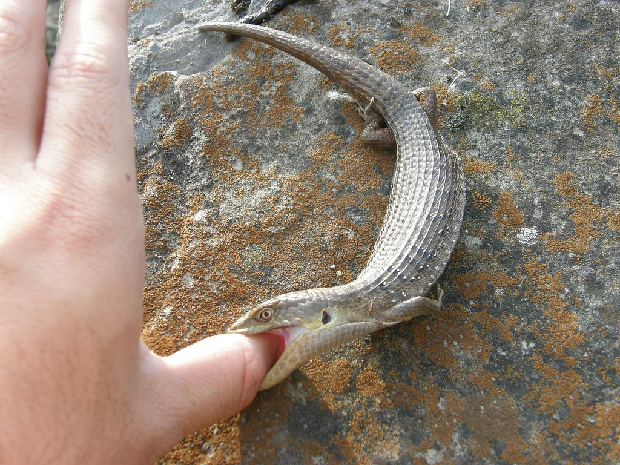
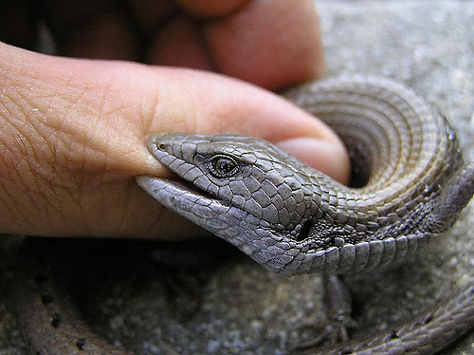
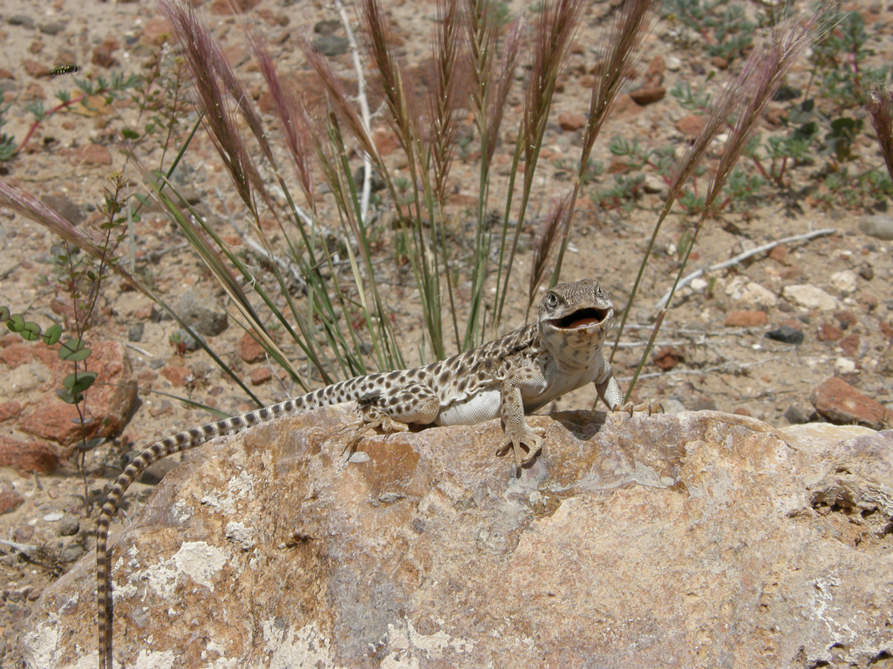

Slide 10
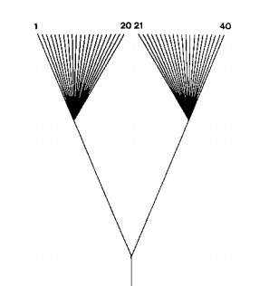
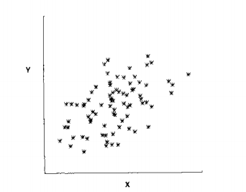
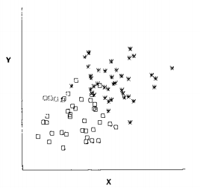
Felsenstein 1985

Slide 11
What do we want to know?
The dynamics of adaptive trait evolution over macroevolutionary time and how these dynamics are influenced by selective factors

Slide 12
What are the characteristics of adaptation?

Slide 13
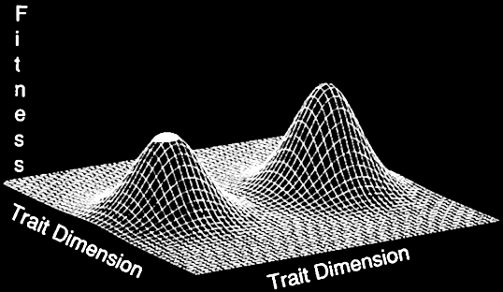
Adaptive Landscapes

Slide 14
What processes affect quantitative trait evolution?
Natural selection
Genetic drift Mutation
et al.

Slide 15
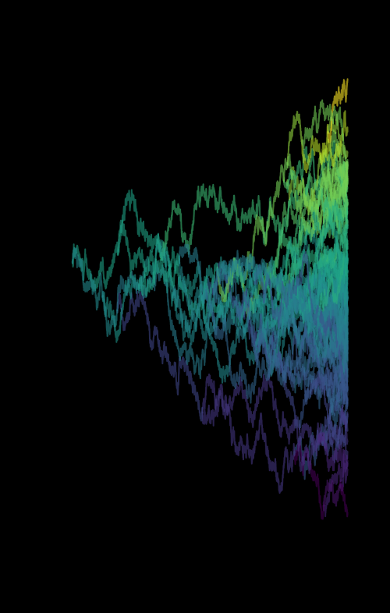
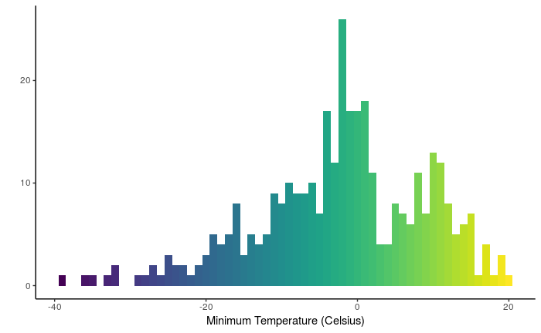
Continuous traits: Gaussian Models

Slide 16
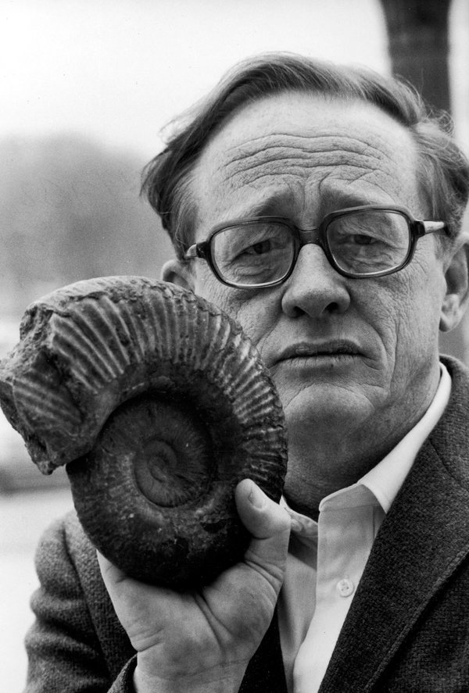
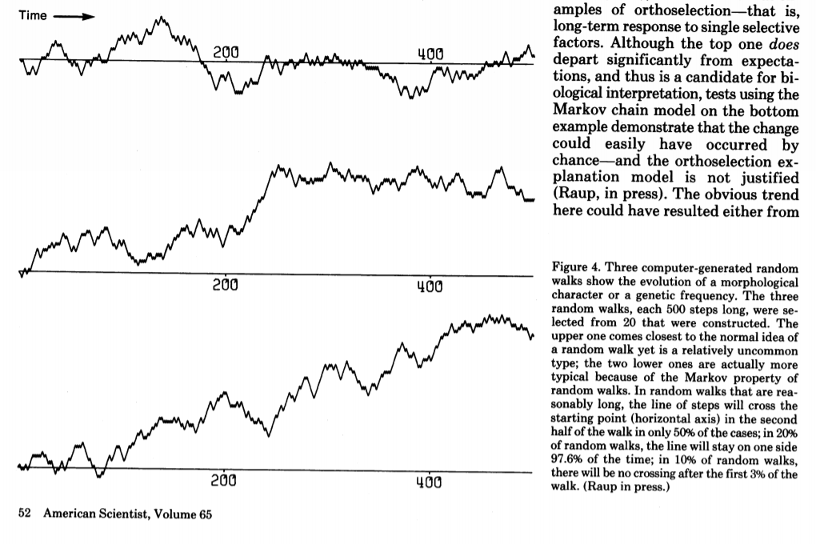
Random walks
Are patterns of trait change in the fossil record significantly different from random?
David Raup

Slide 17
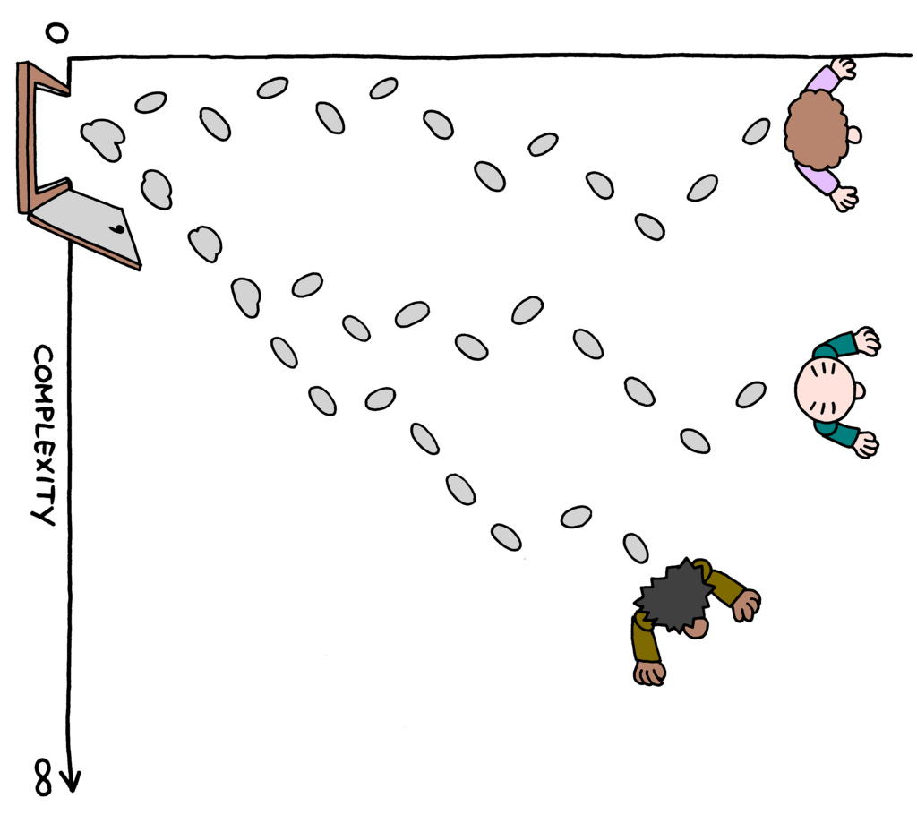
The Drunkard's Walk

Slide 18
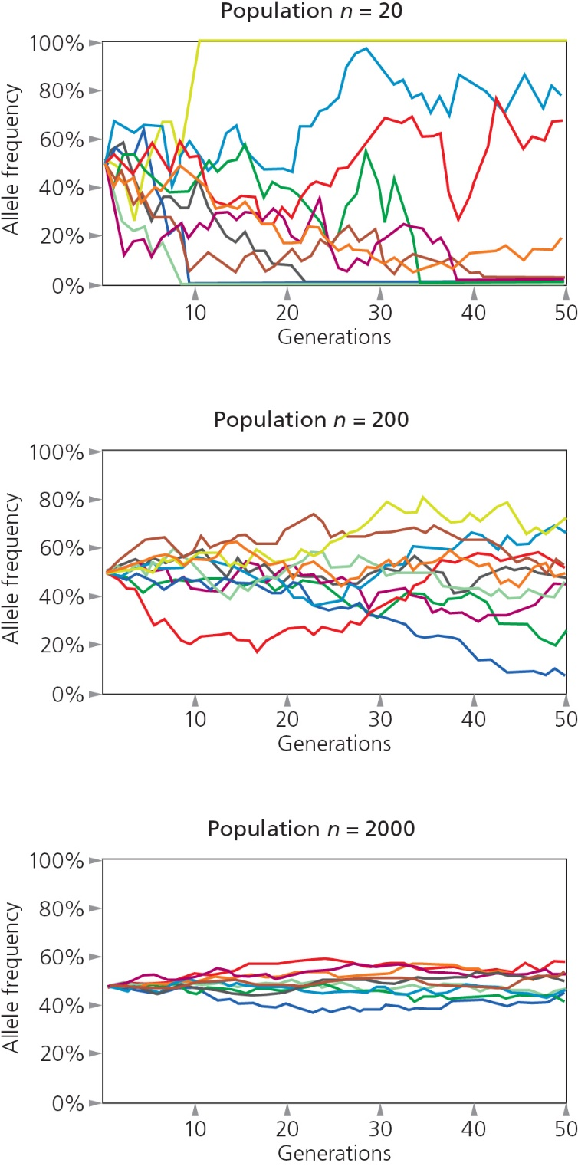
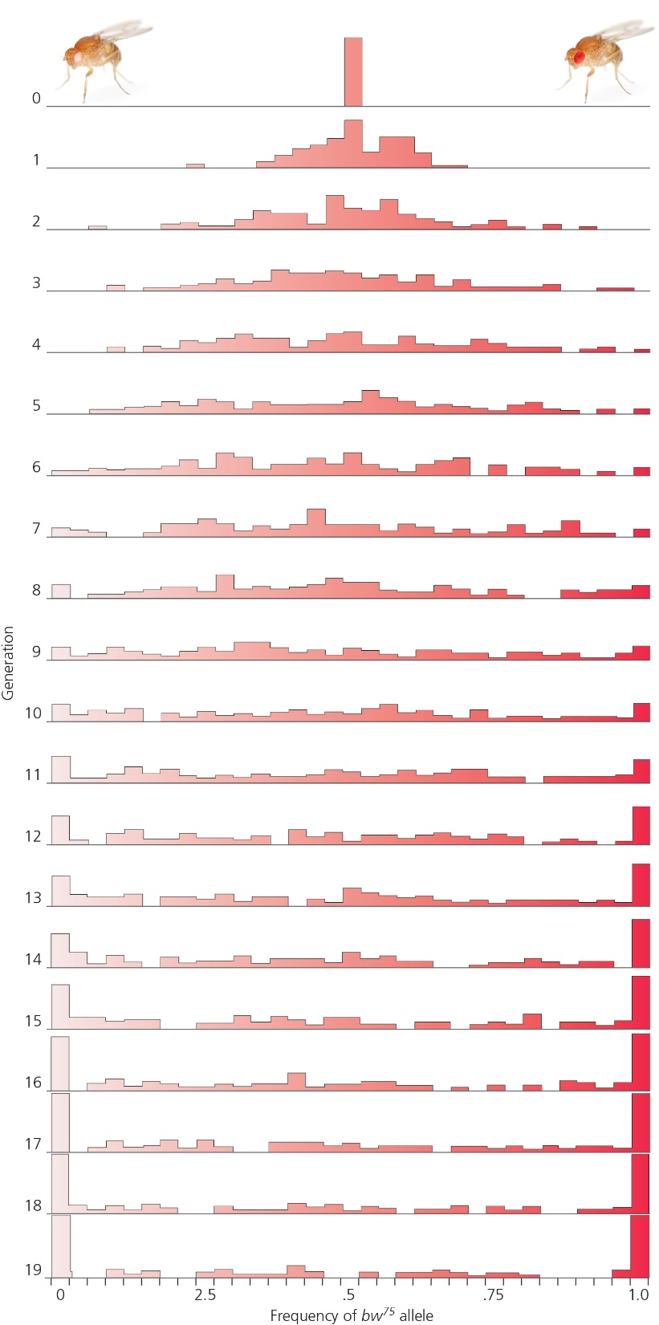
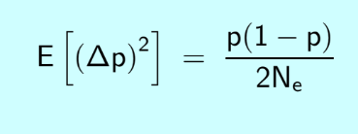
Population genetics
Luca Cavalli-Sforza & Anthony Edwards
Allele frequency evolution by genetic drift can be approximated by Brownian Motion

Slide 19
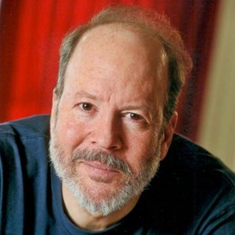
Quantitative genetics
Lande demonstrated that genetic drift in a quantitative character can also be approximated by Brownian Motion
Expected change per generation:
Δz = 0
Variance = G/Ne
Russ Lande
Notice similarity ->

Slide 20
Generalized Random Walk
z_{t+1} = z_{t} + N(μ, σ²)
Cool stats rule: Variances are additive
If:
A ~ N(0, σ_{A}²)
B ~ N(0, σ_{B}²) Then:
A + B ~ N(0, σ_{A}² + σ_{B}²)
and the variance among replicate lineages at time t is then simply = σ² t

Slide 21
So if you take many lineages evolving by a Random Walk with constant step variance for t generations, what is the variance among them?

Slide 22
Continuous time Random Walk = Brownian Motion
dz = μt + σ*dW
Wiener Process

Slide 23
Caution...
Brownian Motion ≠ Genetic Drift

Slide 24
What about adaptation?

Slide 25

Ornstein-Uhlenbeck Process
Δz = α(θ - z) + σ dW
α - Rate of adaptation
Units: (1/time)
σ - Rate of stochastic evolution
Units: trait units/time
θ - Phenotypic optimum

Slide 26
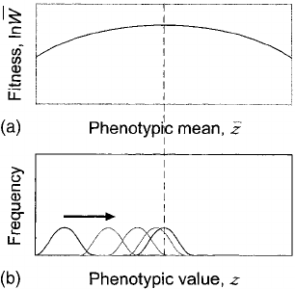
Genetic Drift + Natural Selection
Genetic drift only:
Δz = (G/Ne)^{1/2} dW
Genetic drift + Natural selection to a Gaussian adaptive peak:
Δz = G/(ω + P)*(θ - z) + (G/Ne)^{1/2} dW
Russ Lande
Genetic variance
Distance from the optimum
Width of the adaptive landscape

Slide 27
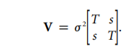
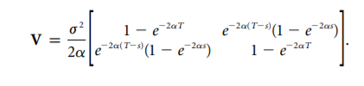
Useful parameterization:
Stationary Variance = σ²/(2α)
The amount of variance among a set of lineages with an infinite amount of time evolving at the optimum
Phylogenetic half-life = ln2/(α)
The expected amount of time for a lineage to get halfway to the optimum

Slide 28
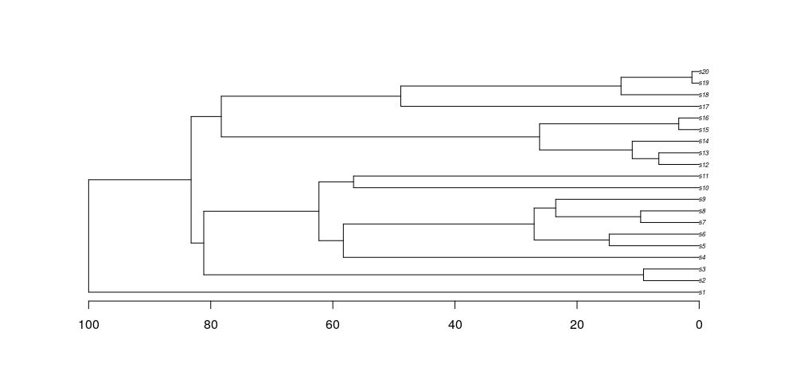
Interpreting half-life
ln2/α
BM-like
White noise
OU

Slide 29
Phylogenetic Half-Life
Measure of phylogenetic signal when a single optimum OU model is fit to the entire tree

Slide 30
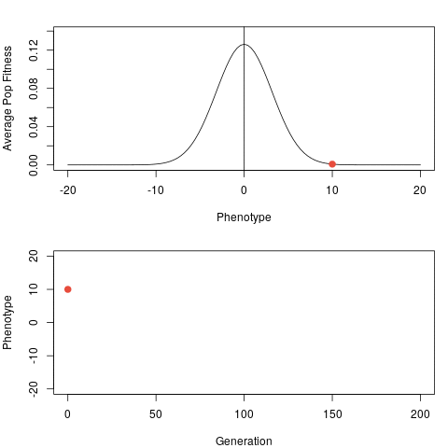
Ornstein-Uhlenbeck process
α = 0.1
σ²= 0

Slide 31
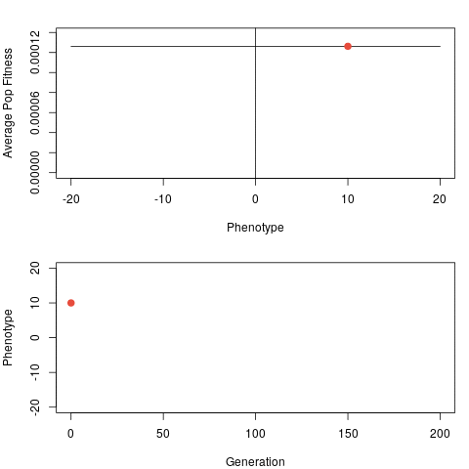
Ornstein-Uhlenbeck process
α = 0.000001
σ²= 1

Slide 32
Ornstein-Uhlenbeck process
α = 0.1
σ²= 1

Slide 33
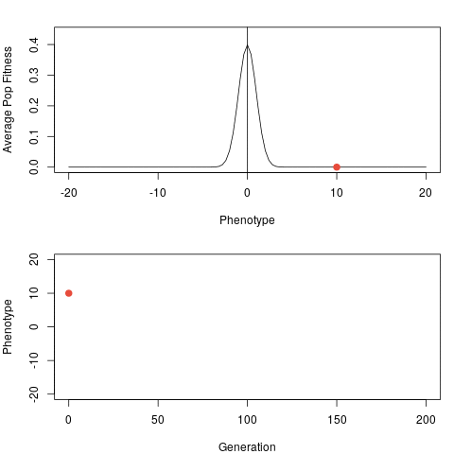
Ornstein-Uhlenbeck process
α = 0.1
σ²= 1
α = 1
σ²= 10

Slide 34
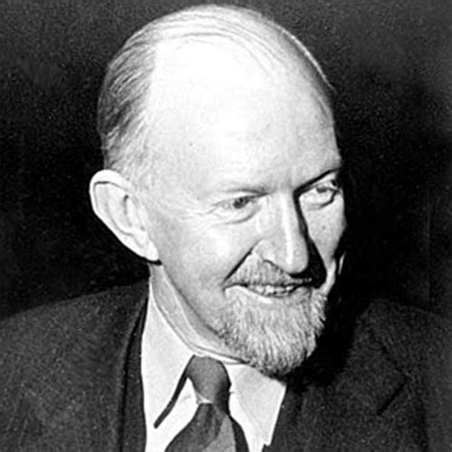
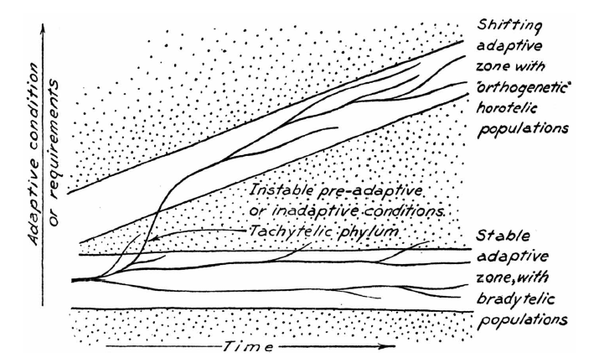
Simpson's Adaptive Zones

Slide 35
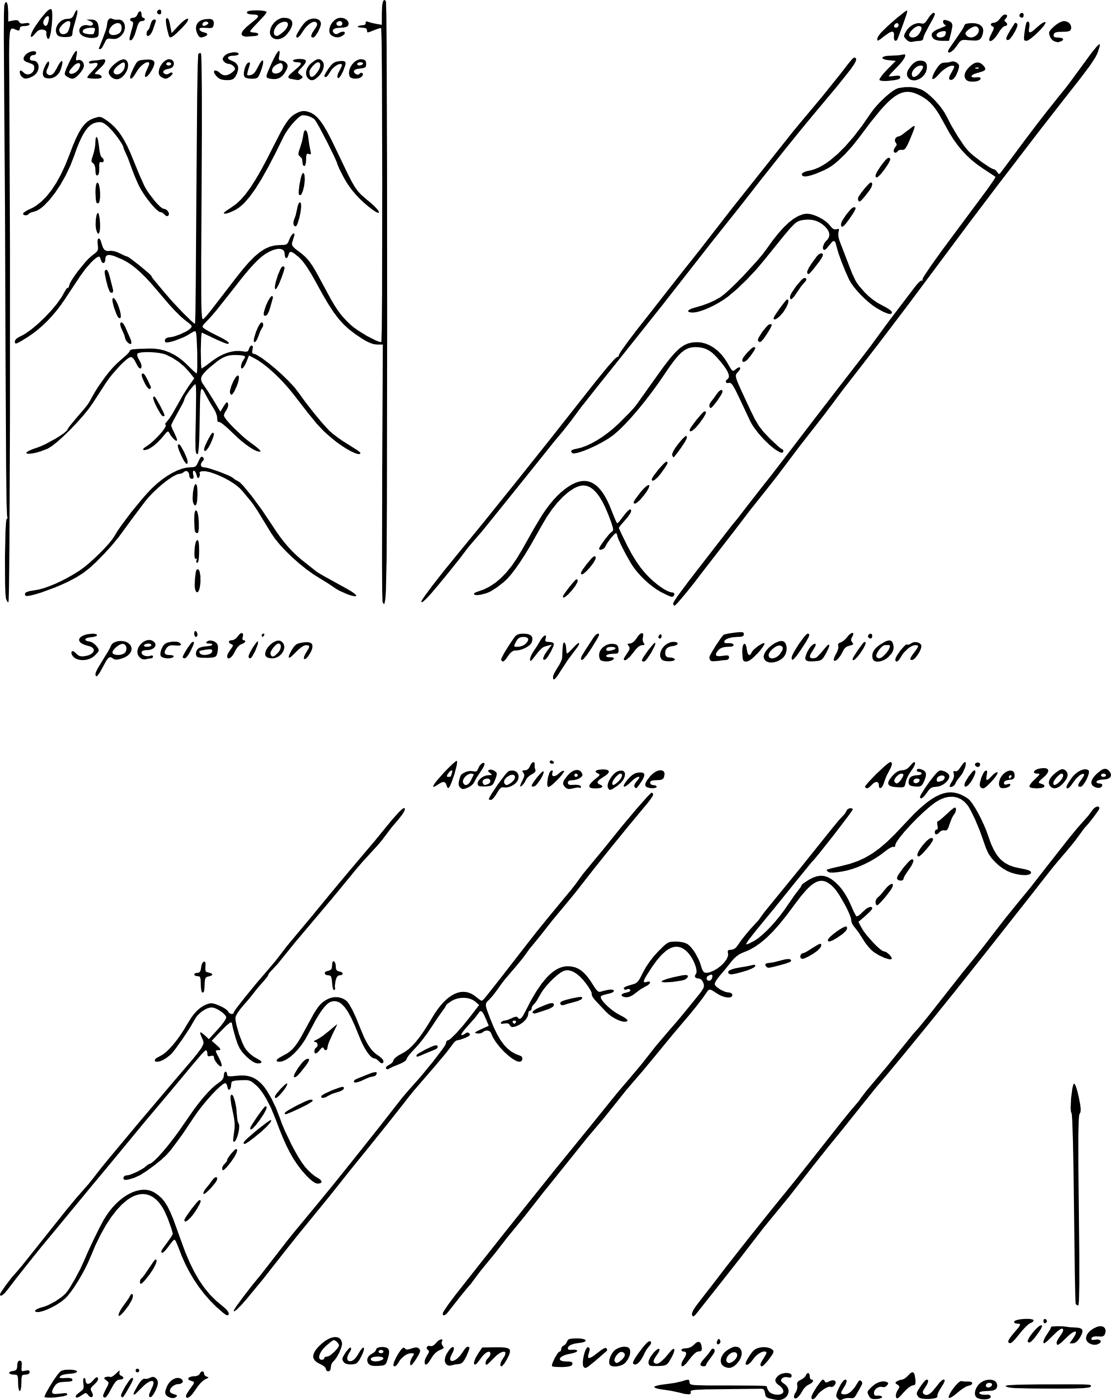

Slide 36
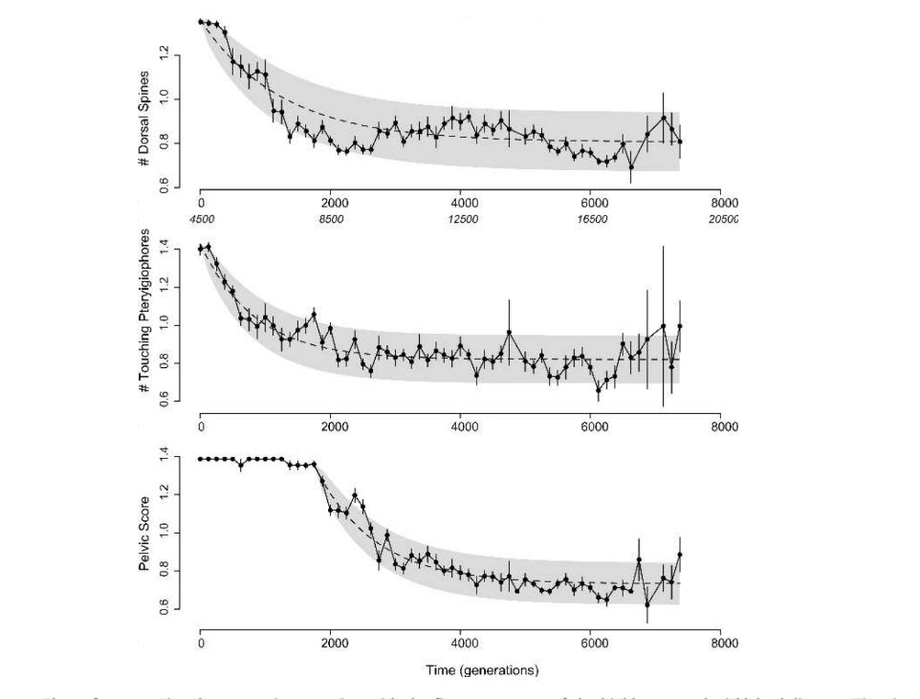
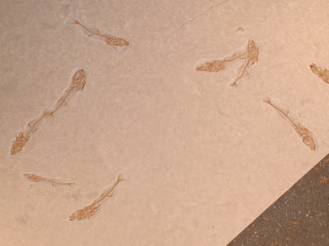
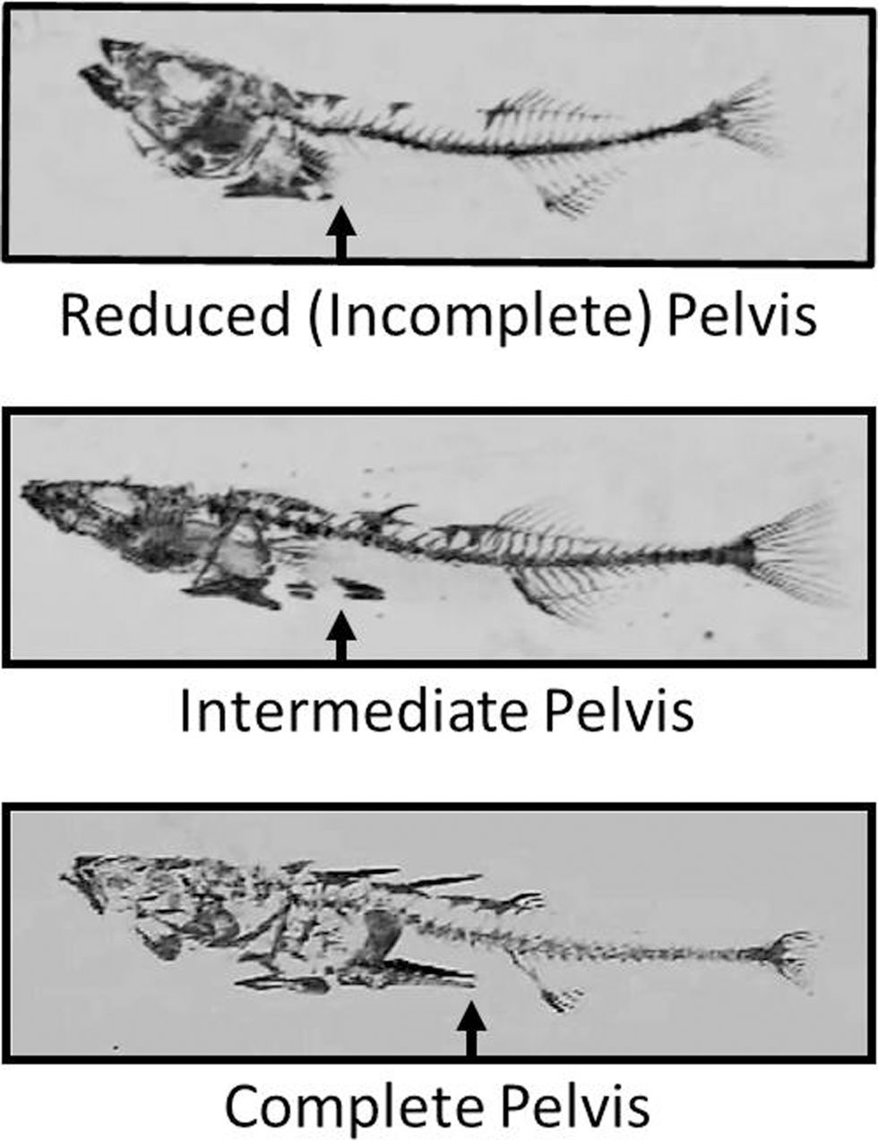
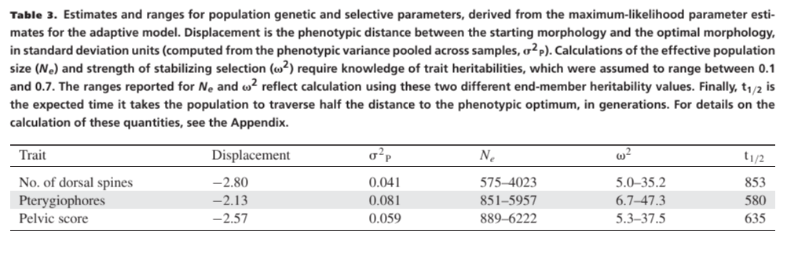
Hunt, Bell & Travis 2007

Slide 37
OU models on phylogenies

Slide 38
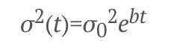
AC/DC model
BM, but with a declining rate parameter:
If b is negative, declining rates (i.e. Early burst)
If b is positive, increasing rates (late bursts, not identifiable from OU in ultrametric trees)

Slide 39
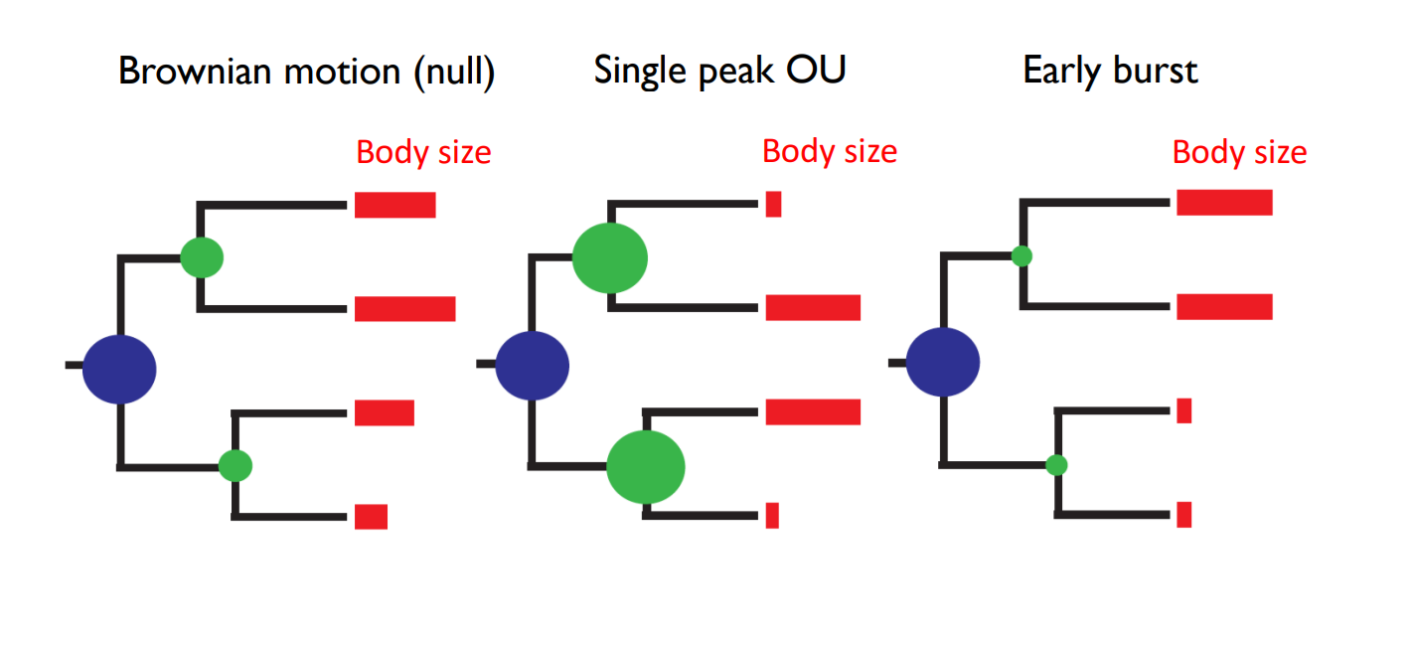
Early Burst -> Brownian Motion -> Ornstein-Uhlenbeck

Slide 40
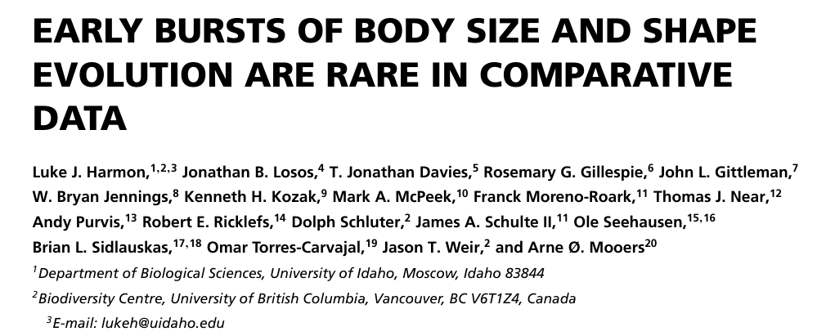
Early Burst -> Brownian Motion -> Ornstein-Uhlenbeck

Slide 41
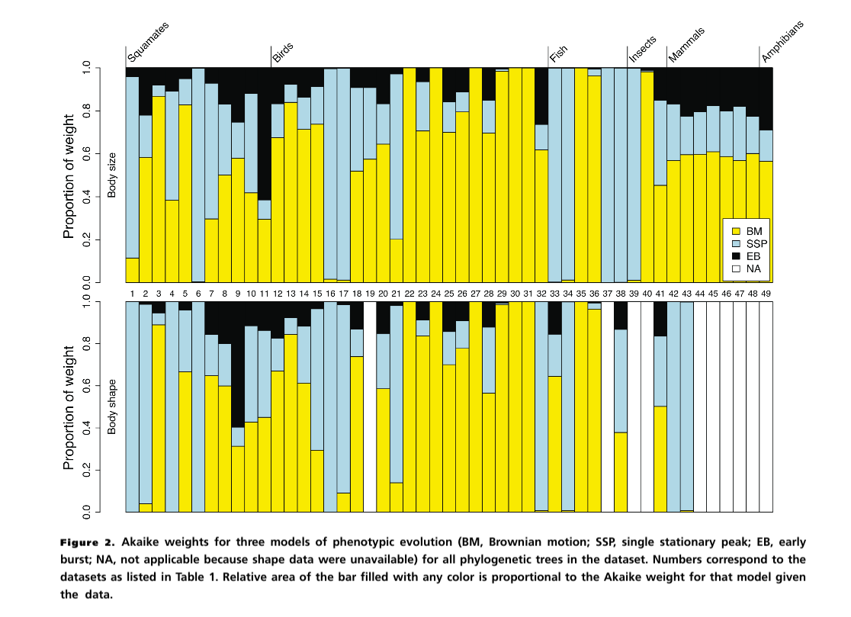

Slide 42
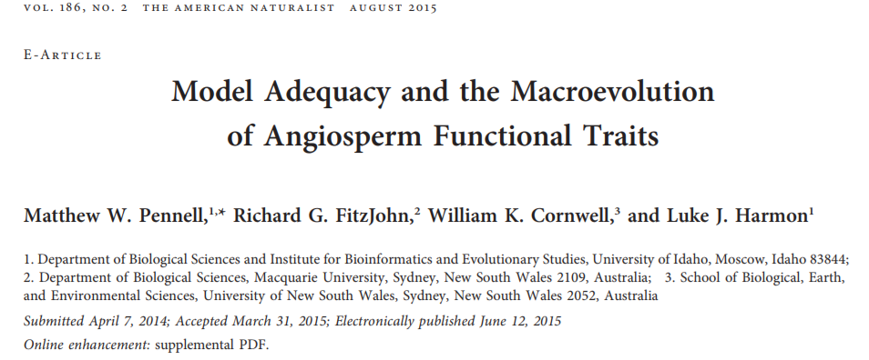
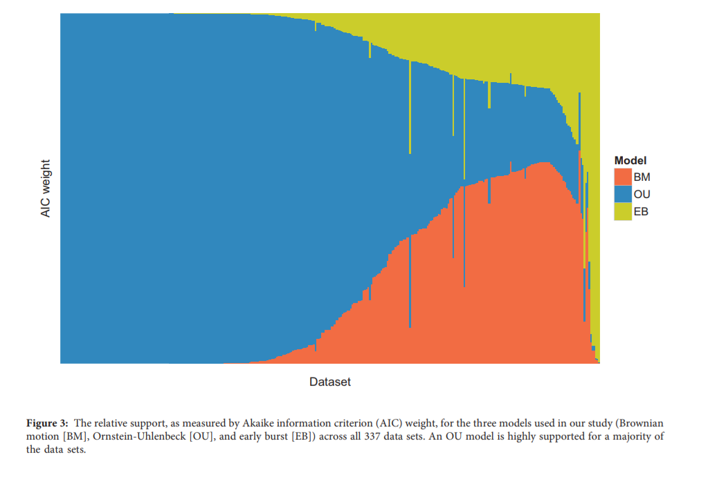

Slide 43
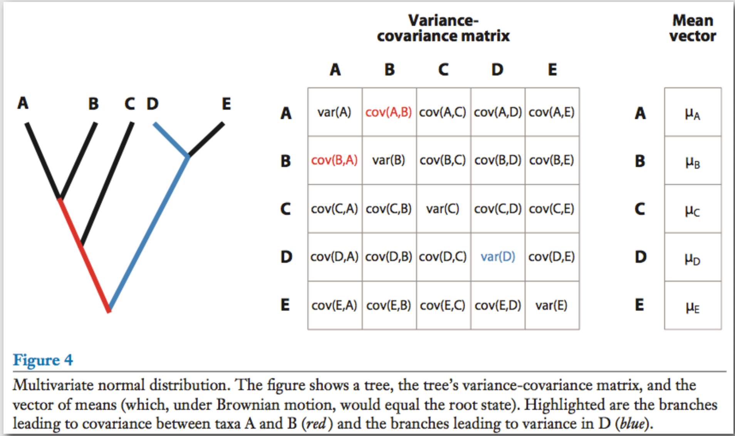

Slide 44
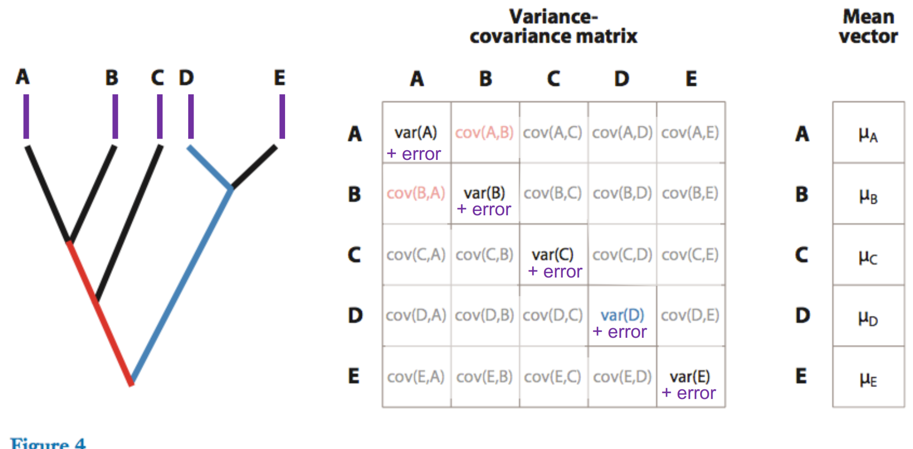
Why we must account for “measurement” error

Slide 45
EB BM OU WN
α = 0
halflife=∞
α
α =∞
halflife=0
OU models
High phylogenetic signal
No phylogenetic signal
ACDC model
(EB/OU)
-
+
0
Contrast
Node Height
test
Root Tip
Node age
Root Tip
Node age
Root Tip
Node age
Measurement error +
“Biological error”

Slide 46
The phylogenetic regression Y ~ X

Slide 47
What is the “Primary Optimum” (Hansen 1997)?

Slide 48
What is a Primary Optimum?
What does alpha measure?
A: Strength of Natural Selection(?)
Problem: What if we measure selection pulling a species AWAY from the macroevolutionary optimum in a natural population?
(This is VERY COMMON!)

Slide 49
Hansen 1997
“Imagine we start with an infinite number of populations …and allow them to evolve independently but with [a] selective factor in a fixed state…the average adaptive optimum eventually reached by these populations is a hypothetical entity different from the actual optimum realized in specific populations, but it is a better measure of adaptation, because it reflects the influence of a selective factor against a maximally randomized background.”

Slide 50
Felsenstein 1985

Slide 51
Why can’t we do “regular” linear regression again?
Non-independence
of species

Slide 52
Y ~ X
X₀
X₁
X₂
X₃
X₄
X₅
X₆
Y₃
Y₄
Y₅
Y₆

Slide 53
Why can’t we do “regular” linear regression again?
Non-independence
of residual error variation

Slide 54
Y ~ X
E₀
Phylogeny
E₁
E₂
E₃
E₄
E₅
E₆
Y₅
Y₆
Y₇
Y₈
Response traits
Predictor traits/
Treatment/
Fixed effects
X₅
X₆
X₇
X₈

Slide 55
Brownian Motion

Slide 56
OUwie ouch SLOUCH (Hansen et al. 2008)
X₀
Y₀
Y ~ X
X₁
X₂
Y₁
Y₂
X₃
X₄
X₅
X₆
Y₃
Y₄
Y₅
Y₆

Slide 57
Multi-optimum OU models Y ~ X_{discrete}

Slide 58
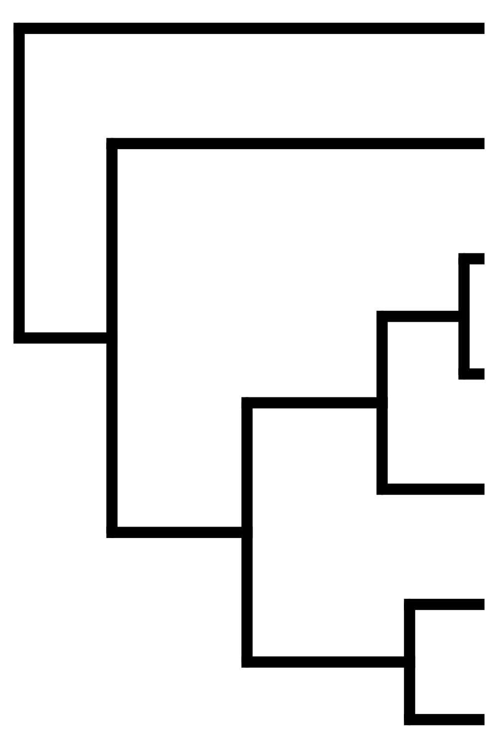
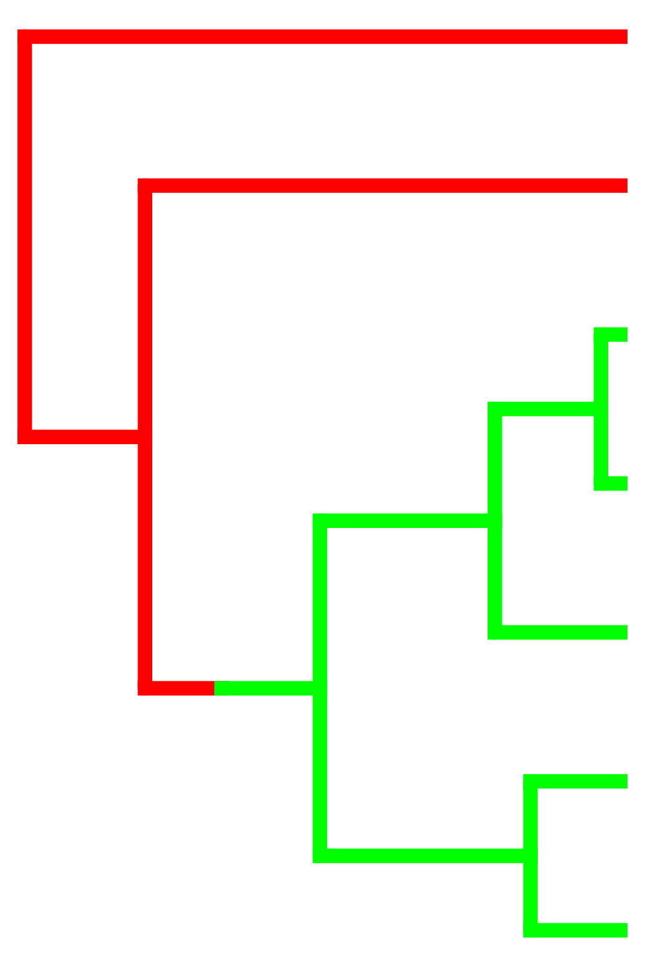
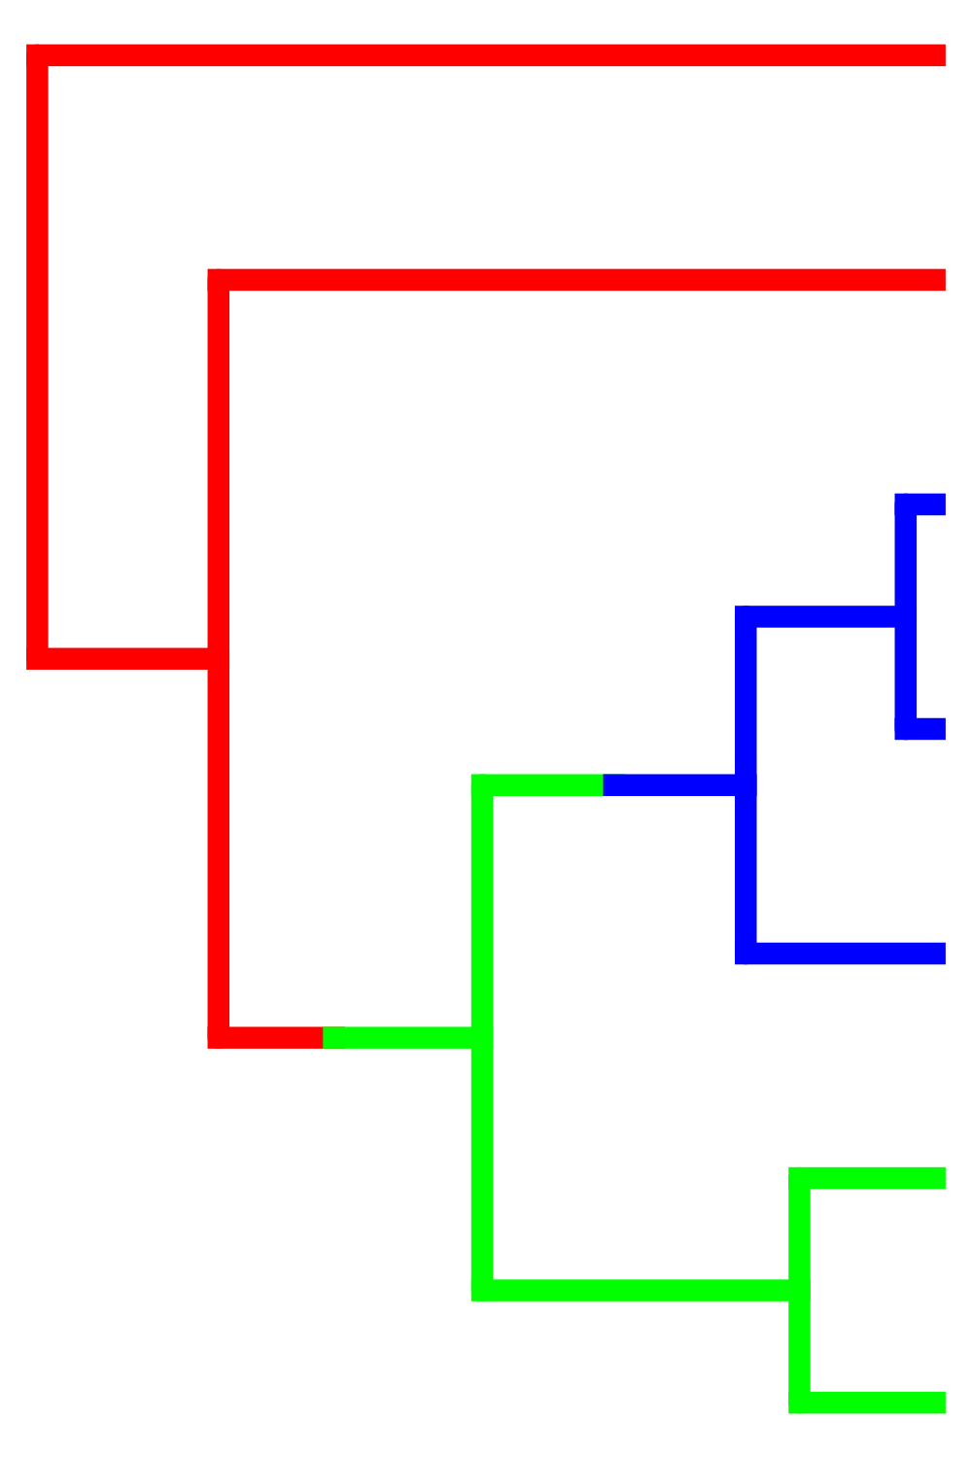







Slide 59
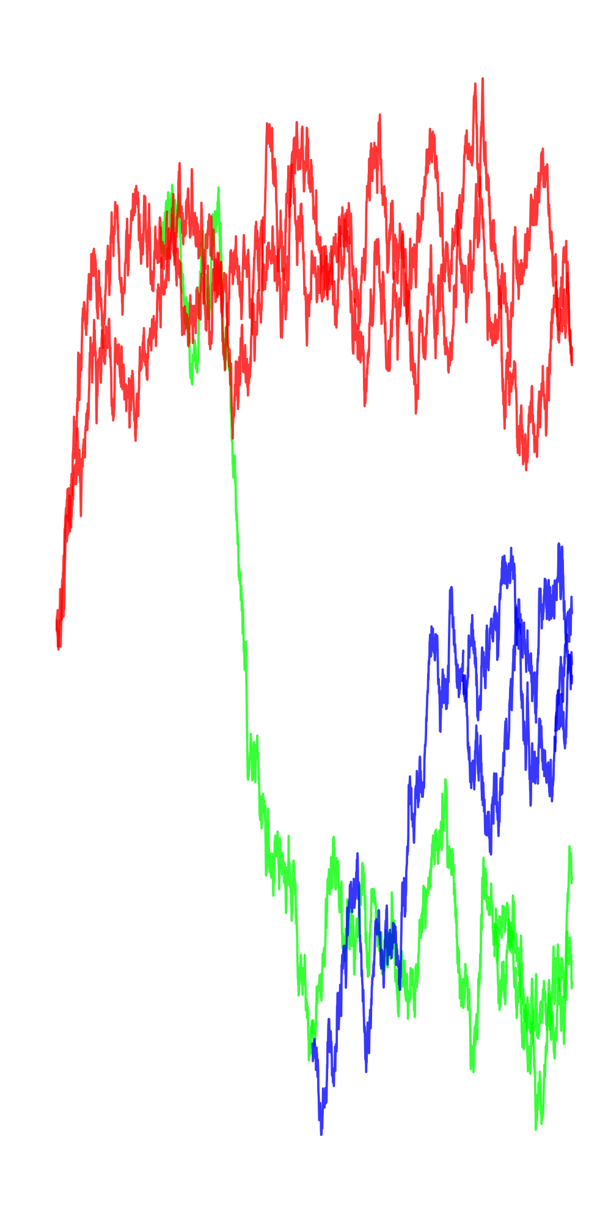
θ₁
θ₂
θ₃
Ornstein-Uhlenbeck
(Hansen 1997, Butler & King 2004)

Slide 60
Compare models
(e.g. by AIC)
Best Model
(Hansen 1997, Butler & King 2004)

Slide 61






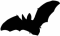




Slide 63

How do we actually do this?

Slide 64



Hansen 1997
Butler & King 2004

Slide 65
Like phylogenetic models, lots of PCMs devoted to heterogeneity in the tempo & mode of evolution over branches
Continuous traits:
BM (bayestraits, Auteur, BAMM, OUwie)
OU (bayou, l1ou, PhylogeneticEM, PCMFit)
Discrete traits
Hidden State Models (corHMM)
Diversification Models (BAMM, HiSSE, FiSSE)

Slide 66
You can change any parameter of the model (or the model itself) at the shift
Brownian Motion - σ²
Brownian Motion w/trend - σ², μ
OU - θ, σ², α
EB - σ², b
Example questions:
Does the rate of evolution change with habitat?
Does niche space expand on islands?
Do ectotherms have more constrained trait evolution than endotherms?
Is gene expression more constant early or late in cancer progression?
Are Anolis lizard ecomorphs convergent?

Slide 67



Do convergent pad-bearing lizards have similar evolutionary dynamics in functional performance?
Travis Hagey

Slide 68

Hagey et al. 2017, Evolution
Geckos:
OU/BM w trend
Unconstrained
Anoles:
Strongly OU
Very constrained

Slide 69
R Demo: Session 1

Slide 70
OU-BM models Y ~ X_{continuous}

Slide 71
OUwie ouch SLOUCH (Hansen et al. 2008)
X₀
Y₀
Y ~ X
X₁
X₂
Y₁
Y₂
X₃
X₄
X₅
X₆
Y₃
Y₄
Y₅
Y₆

Slide 72
Brownian Motion

Slide 73





How does thermal physiology evolve in response to changing temperature?
T_{pref} ~ T_{Env}
Vinny Farallo
Don Miles
Martha Munoz
Farallo, Munoz, Uyeda & Miles. 2020. Scaling between macro- and microscale climatic data reveals strong phylogenetic inertia in niche evolution in plethodontid salamanders. Evolution.

Slide 74
R Demo: Session 2

Slide 75
Phylogenetic Natural History Y ~ X???

Slide 77


Uyeda & Harmon 2014

Slide 78
Two approaches
Hypothesis testing
Tests biological predictors
Best model may be still be bad
Phylogenetic natural history
Descriptive: “stuff happens”
Finds major events

Slide 80


Slide 81


Lizard muscle fibers (Scales et al. 2009)

Slide 82

Predator Escape (PE)
Foraging Mode (FM)
FM & PE

Slide 83
Predator Escape (PE)

Slide 84


Slide 85

Vs.
Foraging Mode (FM)

Slide 86

Combine approaches
W *
+ (1 – W) *
PE

Slide 87


Slide 88


Slide 89


Slide 90
Combine approaches
0.4 *
+ 0.6 *
PE

Slide 91
Predator escape is a good predictor of muscle fibers in lizards!
…and horned lizards
are weird

Slide 92
Method | Shift mapping | α & σ | Multivariate? | Optimum change | Inference approach | Predictors? | Convergent regimes?
OUCH (Butler & King 2004) | User hypotheses | Global | Yes | Discrete | Maximum Likelihood | Discrete regimes | Yes
Ouwie (Bealieu et al. 2012) | User hypotheses/ simmap | Regime-specific | No | Discrete | Maximum Likelihood | Discrete regimes | Yes
mvMORPH (Clavel 2015) | User hypotheses/ simmap | Global | Yes | Discrete | Maximum Likelihood | Discrete regimes | Yes
SLOUCH (Hansen et al. 2008) | None | Global | No | Brownian Motion | Maximum Likelihood | Continuously-evolving predictors | N/A
mvSLOUCH (Bartoszek et al. 2012) | None | Global | Yes | Brownian Motion/OU | Maximum Likelihood | Continuously co-evolving | N/A
SURFACE (Ingram & Mahler 2013) | Data driven (Stepwise AIC) | Global | Pseudo | Discrete | Maximum Likelihood | No | Yes
l1ou (Khabbazian et al. 2016) | Data driven (Lasso) | Global | No | Discrete | Maximum Likelihood | No | Yes
PhylogeneticEM (Bastide et al. 2018) | Data driven (Expectation maximization) | Global | Yes | Discrete | Maximum Likelihood | No | Yes
Bayou (Uyeda & Harmon 2014) | Data driven (RJMCMC) | Global | No | Discrete + | Bayesian | Regression framework | Not with RJMCMC
PCMFit(Mitov et al. 2019) | Data driven (Greedy algorithm) | Regime-specific | Yes | Discrete + | Maximum Likelihood | Yes | Yes

Slide 93
Multivariate OU processes
https://phenotypicevolution.com/?p=208

Slide 94

PCMFit & PCMBase

Slide 95



Slide 96


Slide 97




Primate molars
Dr. Fabio Machado
Virginia Tech
Dr. Carrie Mongle
Stony Brook
Credit: Leslea Hlusko
Notes:
A good example of the work I aim at doing is the one that I am developing in collaboration with Josef Uyeda, from virginia tech, and Carrie Mongle, from Stony Brook, in which we are investigating the evolution of molar teeth in primates.
The mammalian molar is an amazing model for the study of phenotypic diversification for numerous reasons.

Slide 98

Inhibitory Cascade Model (ICM)
Kavanagh et al. (2007)
Notes:
Second, and more importantly, there is a very well described and corroborated model for the development of lower molars, called the inhibitory cascate model. This model dictates some rules that mammalian teeth phenotypes tend to follow.
Specifically, this model says that the relative size or area of individual molars teeth will progressively increase or decrease along the molar row, due to a balance between inhibition or activation factors. So this delineates a natural morphospace, defined by the relative sizes of the second and third molars, making this a perfect subject for our test.

Slide 99

Primate molars have it all!
Paleodata
Modern time-series
Quantitative Genetics
& Developmental models
Comparative
data + trees
Informative Constraints/priors

Slide 100



Inhibitory Cascade Model (ICM)
3rd molar relative size
2nd molar relative size
Notes:
And viola! We have a biologically informed morphospace. What we need now is to construct models of that allows us to test if microevolutionary models can be actually fit to this data.

Slide 101

Mixed Gaussian phylogenetic models
Deterministic
Stochastic
𝜭- Optima
H- Pull toward optima
𝜮- Rate of stochastic change
Mitov et al. (2019)
Notes:
To evaluate this we used the multivariate extention of the OU model under the framework of the mixed gaussian phylogenetic models.
The general from of these models is the one detailed in this differential equation which describes the behavior of the phenotypes through time.
This equation is divided in a deterministic portion and a stochastic portion.
On the deterministic part, we have two main parameters, which are the optima theta, the matrix H which controls the pull to the optima.
On the stochastic portion we have sigma, which is the matrix that defines the stochastic rate of change. If H is a matrix of zeros, then this model is a pure brownian motion model, so it accommodates both models easly.

Slide 102
Mixed Gaussian phylogenetic models
Stabilizing selection
Genetic Drift
𝜭- Optima
H- Rate of adaptation
𝜮- Rate of Drift
Mitov et al. (2019)
Notes:
Under a strictly microevolutionary interpretation these parts can be interpreted as a stabilizing selection portion and a genetic drift portion, with the deterministic parameters describing elements of the adaptive landscape, such as the optima and the rate of attraction of the optima, and on the stochastic portion we have sigma which now can be viewed as the rate of genetic drift.

Slide 103

Mixed Gaussian phylogenetic models
Stabilizing selection
Genetic Drift
𝜭- Optima
H- Rate of adaptation
𝜮- Rate of Drift
Mitov et al. (2019)
Notes:
If we follow this microevolutionary interpretation, sigma is no longer a free parameter, because the rate of drift will be proportional to the amount of genetic variation, here represented by G, on those same traits. In other words, under a microevolutionaty interpretation, sigma will be proportional to G.

Slide 104


Macroevolutionary models
Microevolutionary models
Notes:
We then used this framework to construct microevolutionary models, here in orange, that makes the explicit assumption about the rate of evolution, and macroevolutionaty models which makes no such assumptions. We also fited a mixed model that allows for multi-regime models to be proposed for the dataset. All these models where fit under maximum likelihood

Slide 105

Notes:
Ok, now some results: for both naïve quantifications, we find evidence of a multi regime macroevolutionary models, with allows parameter heterogeneity.

Slide 106
Notes:
For these models, our diversity was diveded on three regimes: one ancestral one that also included tasiidaes, one for lemuriformes, and another one for similiformes, which are monkeys and apes.

Slide 107

Notes:
However, when we evaluate the ICM variables, the preferred model was the microevolutionary OU model, in accordance with our hypothesis, showing that the developmentally informed space provided a bridge to connect micro and macroevolution.

Slide 108

(myr⁻¹)
Notes:
With this conection now made, we can now use microevolutionary theory to map phenomena at large scales. For example we can both quantify the rates of genetic drift over millions of years and visualize the adaptive landscape of teeth evolution in primates.
Looking at these results we can imply that the developmental process seem to impose a corridor like adaptive landscape where primate species are moving almost neutrally within it, producing all observed variation in the fossil record and extant species

Slide 109
More detail on mvOU models....

Slide 110


Slide 111


Slide 112


Slide 113


Slide 114


Slide 115


Slide 116


Slide 117


Slide 118


Slide 119


Slide 120


Slide 121

Quantitative Genetics (Lande 1976)
Genetic Drift + Natural Selection
$∆\overline{z}=\frac{G}{P+ ω^{2}}(θ−\overline{z})+ \sqrt{\frac{G}{N_{e}}}dW$
= Ornstein-Uhlenbeck

Slide 122

Ornstein-Uhlenbeck
Adaptation + Random Evolution
$∆\overline{z}=α(θ−\overline{z})+σdW$

Slide 123


Simpson’s Adaptive Zones

Slide 124

What is meant by this passage? Why does Felsenstein make this argument?

Slide 125
Implementations
Multi-optima OU models (R packages)
ouch (Butler and King )
OUwie (Beaulieu)
SLOUCH (Hansen, Pienaar & Orzack)
mvSLOUCH (Bartoszek)
mvMORPH (Clavel)
surface (Ingram)
l1ou (Khabbazian, Ane and Yu)
bayou (Uyeda)

Slide 126

Quantitative Genetics (Lande 1976)
Genetic Drift
$∆\overline{z}=\sqrt{\frac{G}{N_{e}}}dW$
= Brownian Motion

Slide 127

Quantitative Genetics (Lande 1976)
Genetic Drift + Natural Selection
$∆\overline{z}=\frac{G}{P+ ω^{2}}(θ−\overline{z})+ \sqrt{\frac{G}{N_{e}}}dW$
= Ornstein-Uhlenbeck

Slide 128
Implementations
OUM (ML)
ouch
Ouwie
+ α/σ shifts
OUwie PCMFit
+ evolving predictors
SLOUCH
mvSLOUCH
mvOUM
ouch
mvMORPH
mvSLOUCH
PCMFit

Slide 129
But…
Best model may still be bad
Notes:
This model has some issues when it comes to statistical estimation of parameters (likelihood ridges of correlated parameters).
However, only small areas on that ridge may be biologically realistic or feasible. Ignored by current methods.

Slide 131
Uyeda & Harmon 2014

Slide 132
Implementations
OUM (ML)
ouch
Ouwie
+ shift detection
l1ou (ML + lasso)
surface (stepwise AIC)
bayou (rjMCMC)
+ α/σ shifts
OUwie
+ evolving predictors
SLOUCH
mvSLOUCH
mvOUM
ouch
mvMORPH
mvSLOUCH

Slide 133


Notes:
But recently, there have been many papers questioning the inferences that are made with comparative approaches; perhaps best encapsulated by an entire symposium at a recent evolution conference on the “dark side of comparative methods”.

Slide 134
But…
Best model may still be bad
Biological meaning lost when applied to comparative data
Notes:
This model has some issues when it comes to statistical estimation of parameters (likelihood ridges of correlated parameters).
However, only small areas on that ridge may be biologically realistic or feasible. Ignored by current methods.

Slide 135
Bayesian Reversible-Jump Markov Chain Monte Carlo
Prior on parameters (like normal MCMC)
Prior on number and location of regimes
Special “birth-death proposals” that move between models of different dimensions

Slide 136

Bayesian - biological priors
“Blunderbuss” Parameterization
σ²/(2α)
ln2/α

Slide 137
Uyeda & Harmon 2014
Bayesian - biological priors
Quantitative Genetics Parameterization (Lande 1976)
Stabilizing Selection
α = h²V_{P}/(V_{P}+ω²)
Genetic Drift
σ² = h²V_{P}/N_{e}

Slide 138
Bayesian - biological priors
The strength of OU models is that they represent a realistic process model for how adaptation changes traits over time.
Even weakly informative priors (e.g. believable limits to trait values) can make models “better behaved” & more interpretable.

